Slide 1
AND-gate DNA Circuit for Peptide Drug Secretion in E. Coli
Heidi Neuman, Peter Xu

Slide 2
Background & Motivation
Current treatment for cancers in general
  Surgery
  Radiotherapy & chemotherapy
Bacteria therapy
  Cancerous environment (anaerobic/lactose-rich) induced cell activity
  Periodic lysis
  Secretion
  Quorum sensing
Our proposal: AND gate in E.Coli K-12 strain
Notes:
Modern study usually combines the strategies together using DNA circuit implemented via plasmids.
In our project, we combined quorum sensing and hypoxia-inducible promoter to create an AND-gate circuit, which relies on secretion to administer the medication.

Slide 3
Background & Motivation
Why a simple AND logic?
  Complex circuit is less stable
Why E.Coli K-12?
  Nonpathogenic
  Well-studied with a rich library of components
    Compatible secretion protein
    Compatible hypoxia-inducible promoter
  Naturally prefers anaerobic environment
    Localized quorum sensing

Slide 4
Circuit Design
dCas9
LuxR
LuxI
gRNA1
gRNA2
Lux Promoter
Lux Promoter
dCas9
FNR
Peptide Drug
GFP
NirB Promoter
dCas9
Component already native to E. Coli

Slide 5
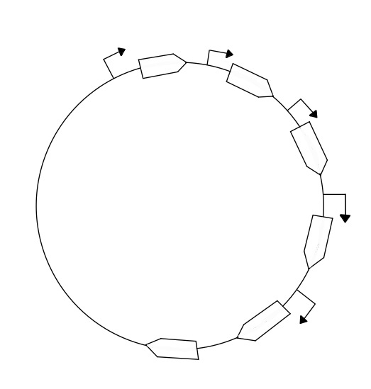
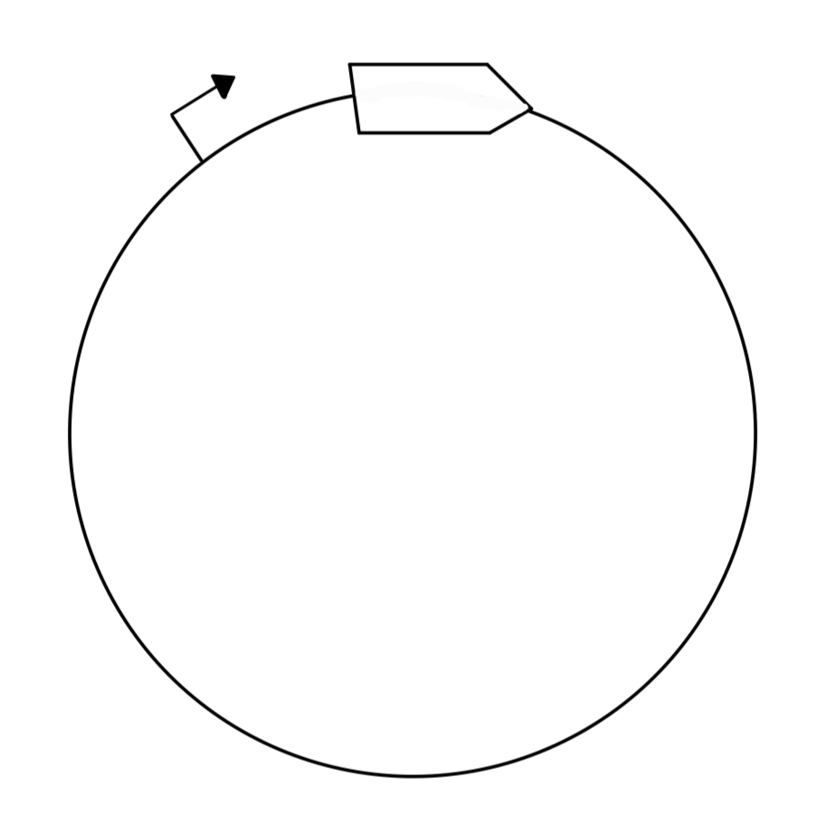
Sequence Design
Plasmid backbone from Addgene
5 inserts designed in Benchling
LuxR
LuxI
gRNA1
Plux Promoter
gRNA1
NirB Promoter
Peptide Drug
gRNA2
LuxR
LuxI
Anderson Promoter
Plux Promoter
Peptide
Anderson Promoter
gRNA2
GFP
GFP
dCas9
Plasmid Backbone from Addgene with dCas9 CDS
Designed the promoter in Benchling
Anderson Promoter

Slide 6
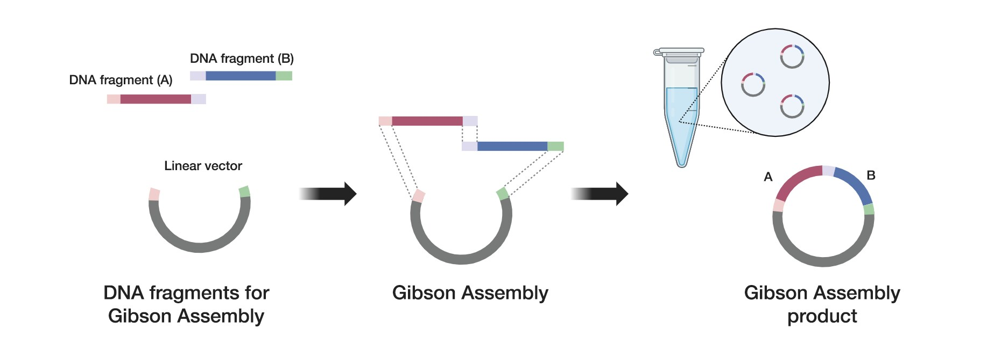
Build
Backbones from Addgene are amplified via PCR with primers ordered from IDT
Inserts with necessary overlaps are ordered from IDT
Figure borrowed from: https://www.thermofisher.com/blog/life-in-the-lab/gibson-assembly-101-expert-cloning-tips-you-need-to-know/

Slide 7
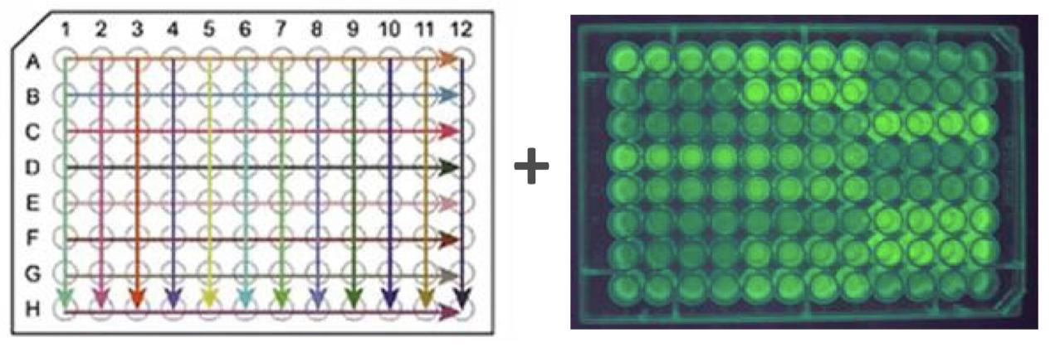
Test
We assume the production of GFP is equivalent to Peptide Drug
In each tube, we keep the population of bacteria constant while varying the oxygen level and AHL concentration
AHL is extracted during the growth of bacteria
Figure borrowed from Lecture 14, Page 31

Slide 8
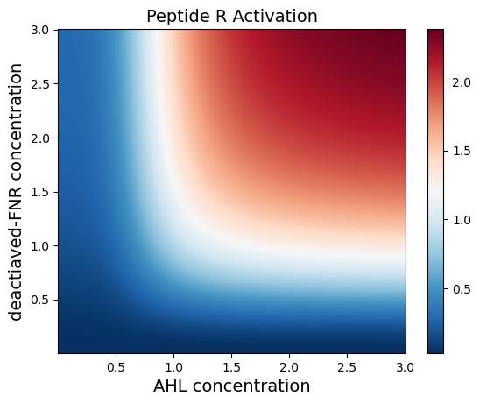
Learn
Fluorescent signal is converted to GFP density
Matrize the GFP density to plot a heat map
Compare against the ideal AND-gate under mass kinetic assumption

Slide 9

Budget & Timeline
Synthesizing sequences ~ 1wk
Assembling plasmids ~ 2wk
Component | Cost | Source
DNA - 2 plasmids, 4 primers, 6 inserts | $829.17 | Addgene and IDT
E. Coli Strain K-12 | $86 | ATCC
Total | $915.17
Computational analysis ~ 0.5wk
Running experiments ~ 1wk
Figure borrowed from Lecture 24, Page 18

Slide 10
Limitation & Future Directions
Testing is limited
  Oxygen binding rate with FNR protein is ignored
  GFP indirectly reports the secretion of Peptide R
  AHL quorum sensing is simulated by manually tuning AHL concentration
What is next
  Incorporate the oxygen-FNR reaction and AHL production in the model
  Make oxygen the sole independent variable in testing
  Test the anti-tumor effect in mice model
Notes:
At the end, the current testing is restricted to the CRISPRi system on nirB promoter.

Slide 11
References
Tiffany Chien, Anjali Doshi, and Tal Danino. “Advances in bacterial cancer therapies using synthetic biology”. In: Current Opinion in Systems Biology 5 (2017). • Synthetic biology• Development and differentiation, pp. 1–8. issn: 2452-3100. doi: https://doi.org/10.1016/j.coisb.2017.05.009. url: https://www.sciencedirect.com/science/article/pii/S2452310017300975.
Crescenzo D’Alterio et al. “New CXCR4 Antagonist Peptide R (Pep R) Improves Standard Therapy in Colorectal Cancer”. In: Cancers 12.7 (2020). issn: 2072-6694. doi: 10.3390/cancers12071952. url: https://www.mdpi.com/2072-6694/12/7/1952.
Hongwei Liao et al. “A PROTAC peptide induces durable -catenin degradation and suppresses Wnt-dependent intestinal cancer”. In: Cell Discovery 6.1 (2020), p. 35. doi: 10.1038/s41421-020-0171-1. url: https://doi.org/10.1038/s41421-020-0171-1.
Reza Nasr and Mohammad Reza Akbari Eidgahi. “Construction of a Synthetically Engineered nirB Promoter for Expression of Recombinant Protein in Escherichia coli.” In: Jundishapur J Microbiol 7.7 (July 2014), e15942.
Kotaro Sakamoto et al. “The K-Ras(G12D)-inhibitory peptide KS-58 suppresses growth of murine CT26 colorectal cancer cell-derived tumors”. In: Scientific Reports 12.1 (2022), p. 8121. doi: 10.1038/s41598-022-12401-3. url: https://doi.org/10.1038/s41598-022-12401-3.

